Slide 1
Data Scientist’s Cookbook: Problem Formulation & EDA
12/08/2021

Slide 2
A bit about myself…
Work on travel insurance with the actuarial team at nib
Insurance premium modelling
Reserve modelling
Sales forecasts
Resourcing forecasts
Other ad-hoc issues
Have been trying to unpack what’s going on in data science for the past ~3 years
Github repository
DS blog (in the midst of migration)

Slide 3
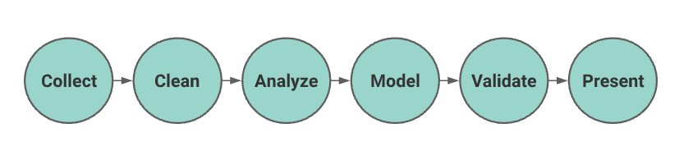
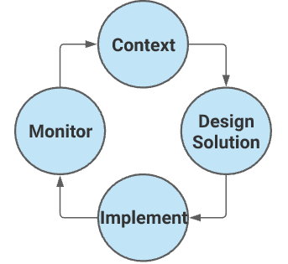
Background
Data science pipeline
Will not stray far from this in a google search
Why is it a linear process?
This is more like the Kaggle pipeline
Actuarial Control Cycle
At least this is circular/iterative
Quite vague
In actuarial exams, if you quoted this as an answer you’d fail instantly
Notes:
Here validate includes testing
If I were to follow the data science process strictly, I’d immediately fire up the IDE to start collecting data after maybe receiving the email request
I’ll end up with processes that don’t work which feed into a model that barely runs, producing results that makes no sense which no one will use

Slide 4
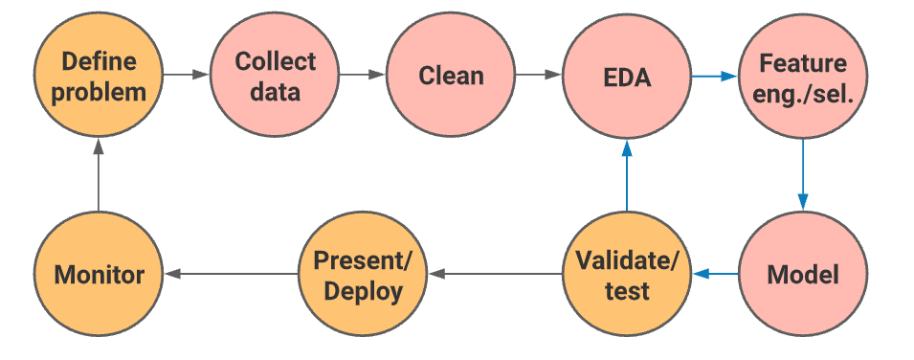
“My” pipeline
Ensemble model
Not all data science projects involve the red circles
Today’s presentation will focus on problem definition + EDA
No “right way” to do it, but there are best practices and frameworks
Notes:
Those in red will probably vary depending on the requirements of the project
Talk briefly about the pipeline
Today we will be talking about top left node, define problem and the EDA one.
At one end of the spectrum, you have a box checking exercise as you go through the pipeline, with very clear tasks and outcomes
On the other end, we have someone just doing whatever whenever, darting all over the place.
What this aims to do is to provide a mental model/frame that let’s you sit somewhere in the middle of this spectrum.
While you do have some checkboxes to go through, different problems would require you differ your tasks

Slide 5
Problem Formulation: Why bother?
Sometimes an incoming ticket/issue is not straightforward
A vague and unmeasurable problem may not be efficiently solved as a data science problem
High-level policy should always dictate low level implementation, not the other way around
Accountability/ documentation
Notes:
Sure, if we’re talking about something like Kaggle or other data science competition websites, the problem is usually very clear and concise. But this is not the case in reality for most of the incoming issues.
Before jumping in, we’d always want to ask ourselves if a DS solution is the way to go?
The point of tackling an issue from a data-driven perspective is to ultimately derive actionable insights from quantifiable results/ impacts.
If this step isn’t done, most of the time down the road what you are going to find is that low level details will start to drive your high-level decisions.
This is especially true for longer term projects, where you’ve jumped right in before problem formulation and you find that you have to refactor stuff at every step, and end up compromising on some potentially good decisions to avoid accumulating more tech debt.
It is just good practice for future reference as well. Imagine going into a github repo with no form of context/background in the README, just straight into the code.

Slide 6
Framework for problem formulation
There is no 1 fixed way to do this, but here is a general framework:
Clearly outlining the business problem, in a concise 1-liner
Scoping
Categorize the type of modelling required
Write of review proposed KPIs/deliverables to track
Decide on your tools/libraries (optional)
Notes:
Let’s be honest, not all data science problems involve a model. But for the purposes of this presentation let’s assume that they do.
Deliverables could be a set of prices, a dashboard, a word doc report of analyses on a certain issue, or a combination of these.
(3) May depend on the scale of the project, but it is
Extend this not just to the results but interpretability requirements as well. What kind of statements do I need to be able to make at the end of the day?
Ideally not every step in problem formulation and EDA will directly feed into the decisions in the next, but as we will see later, some do.

Slide 7
The 1-liner statement
THE PROBLEM
IMPACTS
WHICH EFFECTS
A GOOD STARTING POINT WOULD BE
THE PROBLEM
Is that a particular new insurance portfolio currently has no technical pricing models
IMPACTS
The business’s ability to make informed decisions on price adjustments
WHICH POTENTIALLY AFFECTS
The sales performance
A risk of adverse selection
A GOOD STARTING POINT WOULD BE
Assess the claims of a similar existing book
Model the expected claims costs and add an additional factor loading on top
Notes:
Common template for problem definition, but it works well.
Kind of similar to user stories
Note the red keywords. These should drive the next few steps.
For example, “model expected claims costs” will give you a better idea of the scope of the project + the kind of predictive modelling problem it is

Slide 8
Scoping (example)
Example: An analytics task to determine if health markers correlate to personal wealth
Example: A Kaggle project to model housing prices in Boston
Notes:
Say our project involves

Slide 9
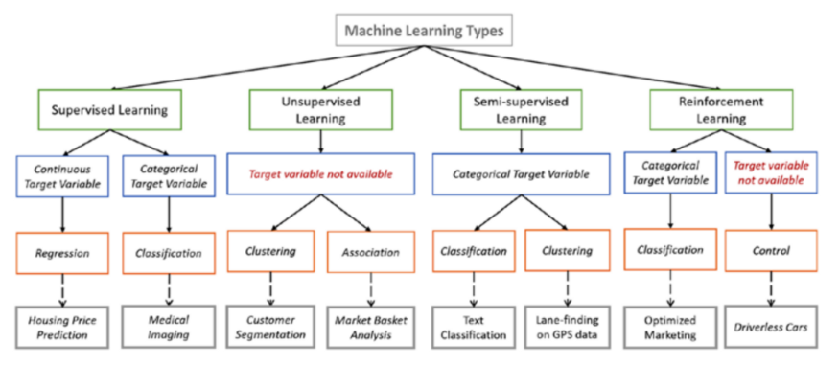
Categorize required modelling
https://towardsdatascience.com/types-of-machine-learning-algorithms-you-should-know-953a08248861
Notes:
Once this is formally categorized, it will narrow down the list of algorithms available

Slide 10
Define KPIs + deliverables
Example
A set of proposed technical rates
A clear list of assumptions used
A table of coefficients with driving factors and loadings for features
RMSE score as main metric (maybe ± 10% of response)
Estimated sales/LR impact for 1 year
Sensitivity analysis of impacts sales/LR at the 50th, 75th percentile
This needs to be reproducible every quarter for review
Notes:
This is driven by the impacts section of the 1-liner.
Determines the level of interpretability required
Also driven by the model categorization
Ect. RMSE
Setting this up also gives the user a good idea of:
What models to potentially start with
What slices of data should be used in EDA
This does not assume a perfect world where requirements are set up front and do not change after, but it serves as a good base for narrowing down the issue

Slide 11
Problem formulation summary
By the end of the exercise you’d have:
An outline of the business problem translated into data problem
An idea of the tasks that are required and the workflow
A narrowed down bucket of machine learning algorithms available that are fit-for-purpose
A narrowed down slice of the overall data to focus on for next steps
A high-level list of deliverables to work towards while performing next steps in the pipeline

Slide 12
Exploratory Data Analysis
Why bother?
Build intuition for the data
Inform model selection and feature selection
Identify patterns and develop hypothesis
Accountability/documentation
Challenge assumptions
Answer questions you didn’t have (bonus)
Notes:
Even if you are dealing with the same dataset, a different problem will force a new perspective on it.
Inform model selection
Here, we open the old aiforsea project and go through an example of how useful EDA is for a future reference.
For heavy excel users, think of it this way. Doing up a model without any EDA is like doing all the spreadsheet workings, then copy pasting as values and saving over it.
The idea is go through and iterate through the EDA process, and throw the feature columns into one of these buckets along the way.

Slide 13
Framework for EDA
Toolset
.describe()
UDFs
Histograms/KDE
Scatter matrix
Correlation (Pearson, Kendall, Spearman)
4 mental buckets
Outliers and scaling, suspicious values
Class imbalance
Oh definitely need to include this ( or some combination)
Oh definitely exclude this

Slide 14
Example: Travel insurance dataset
Target: Claim Status
Name of agency
Type of travel insurance agencies
Distribution channel of travel insurance agencies
Name of the travel insurance products
Duration of travel
Destination of travel
Amount of sales of travel insurance policies
Commission received for travel insurance agency
Gender of insured
Age of insured
Notes:
Of course a DS brownbag will not be DS brownbag without an example

Slide 15
TO THE NOTEBOOK

Slide 16
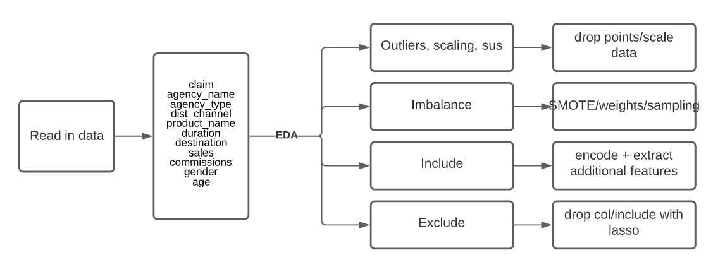
EDA Summary

Slide 17
Summary
Follow up from 4 buckets
Class imbalance, evidence of parametric fit ect.
Define problem -> collect -> clean -> EDA -> feature engineer -> model -> validate/test -> present -> monitor
Level of interpretability
KPI thresholds
Time period slice

Slide 18
THANK YOU

